Slide 1
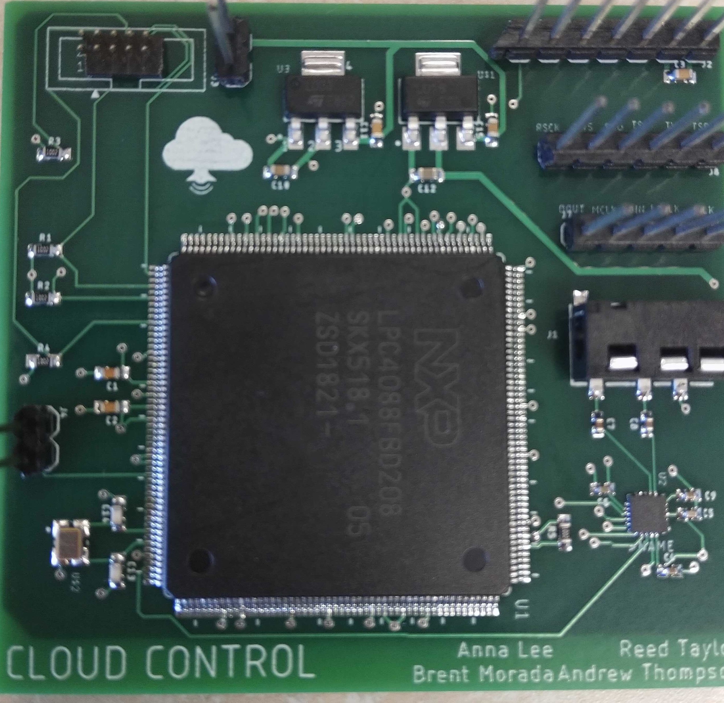
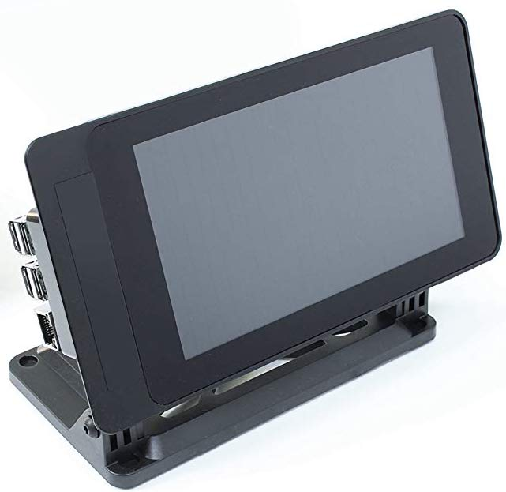
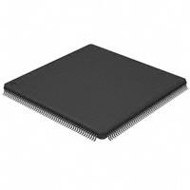
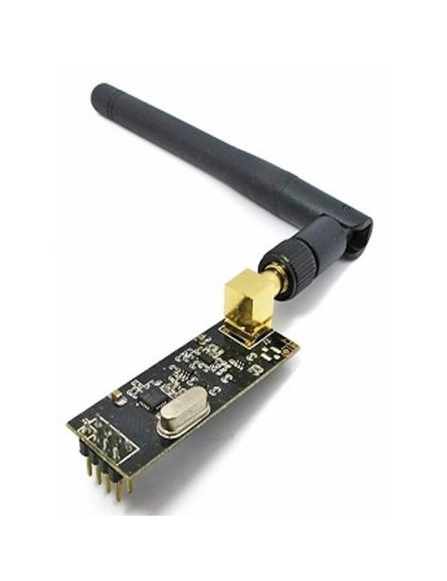
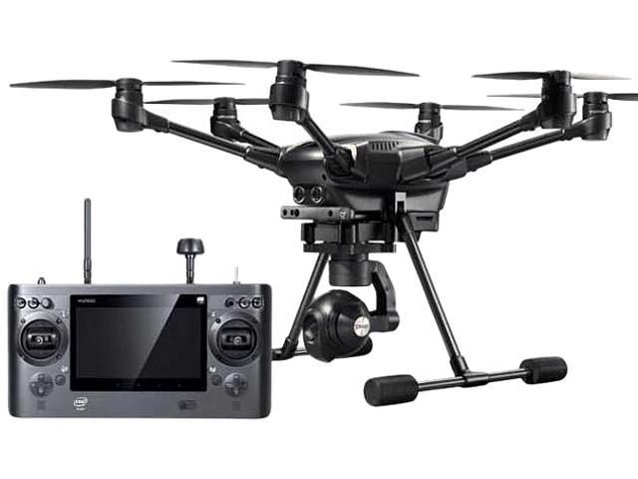
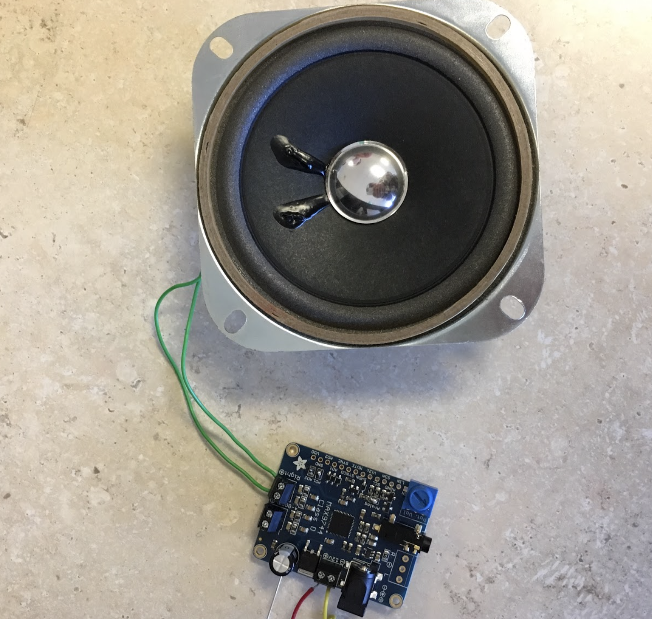


Cloud Control
Andrew Thompson | Reed Taylor| Brent Morada | Anna Lee
Background
PCB Design
Critical Hardware Components
Communicating with groups of people during an emergency situation is an extremely important and challenging task. The Cloud Control project aims to relay messages from a ground control system to a target audience under a drone without being physically present.
Ground Control System:
User interface running on Raspberry Pi touch screen with a microphone
f
Drone Module:
PCB with speaker system mounted on hexacopter drone
Raspberry Pi Ground Control System
Touch screen user interface which records audio via a microphone and transmits the audio samples through the NRF24 sending module.
LPC4088 Microcontroller
Main chip on the PCB which receives digital audio samples from the NRF24 receiving module and passes them to the audio codec.
User Interface
Insert figure
NRF24 Wireless Module
Wireless transmitters connected to both the ground control system and the PCB for sending/receiving audio samples
Drone
Audio Codec
Description
Software Design
Ground Control System:
Python user interface running PyAudio which passes binary audio samples to be sent over the NRF sending module
Drone Module:
NRF receives the binary audio samples and passes them to the microcontroller
The microcontroller passes the samples to the audio codec which converts and outputs an analog signal to the speaker system
Speaker System
Description
Yuneec Typhoon-H
Hexacopter drone with max lifting capacity of 4 lbs.
Quiet for a drone of this size (comparable volume to a quadcopter)
Acknowledgements:
Special thanks to Phil Tokumaru, Yogananda Isukapalli, Brandon Pon, and Carrie Segal.

